Slide 1

Artificial Intelligence Lecture 5

Slide 2
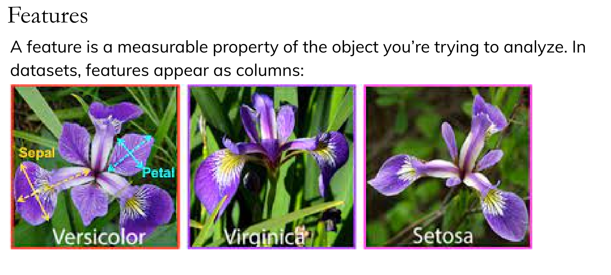
Preprocessing and Feature Transformations

Slide 3
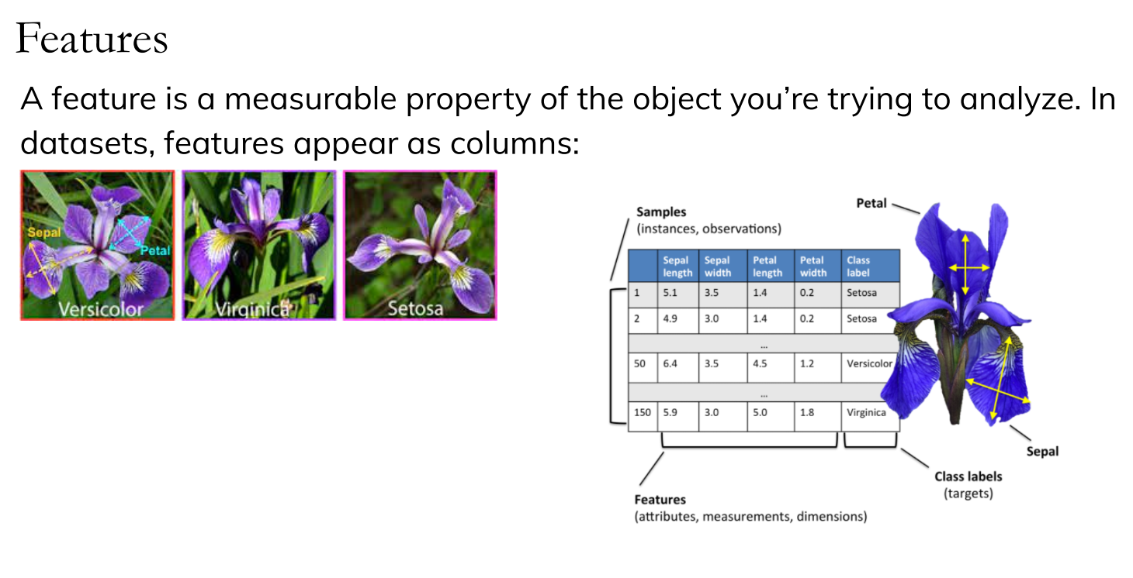

Slide 4
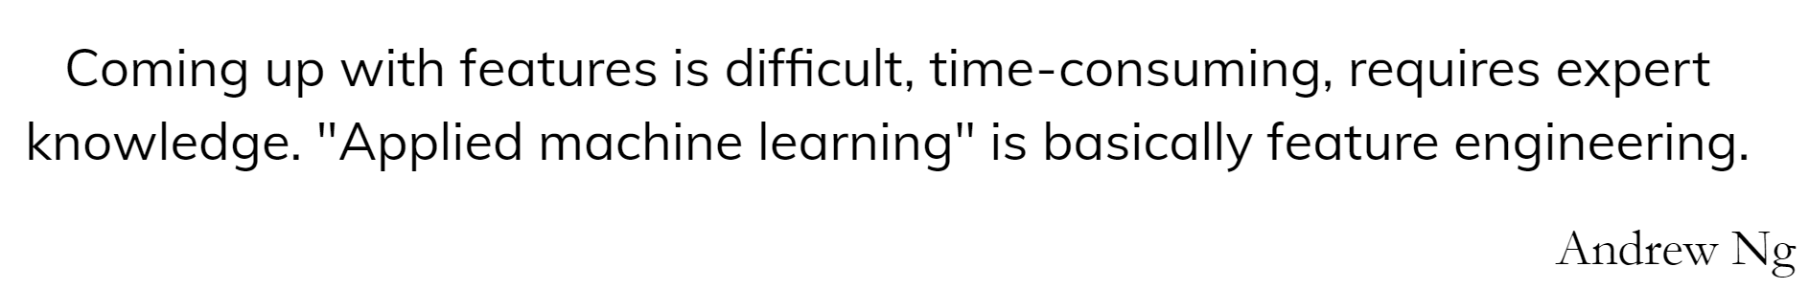

Slide 5
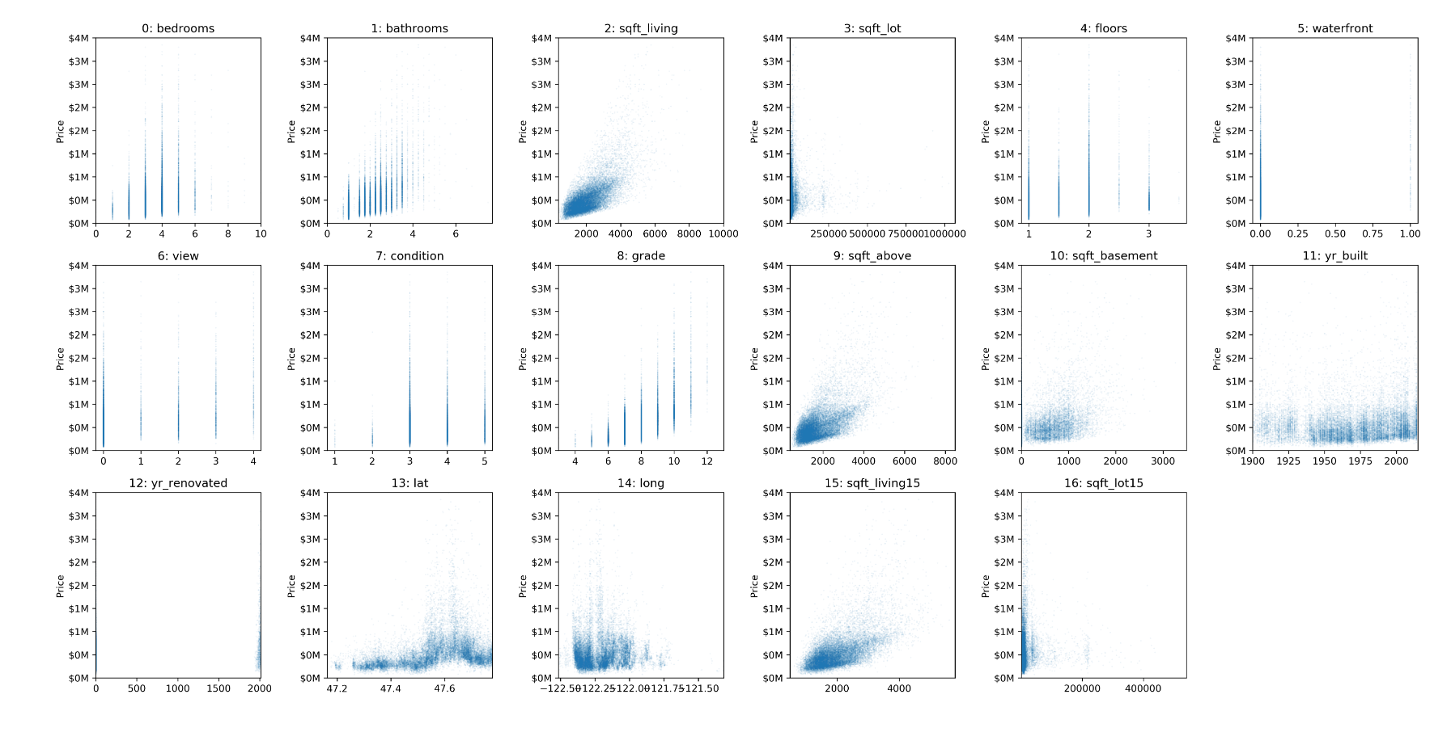
Example of House Price Prediction dataset

Slide 6
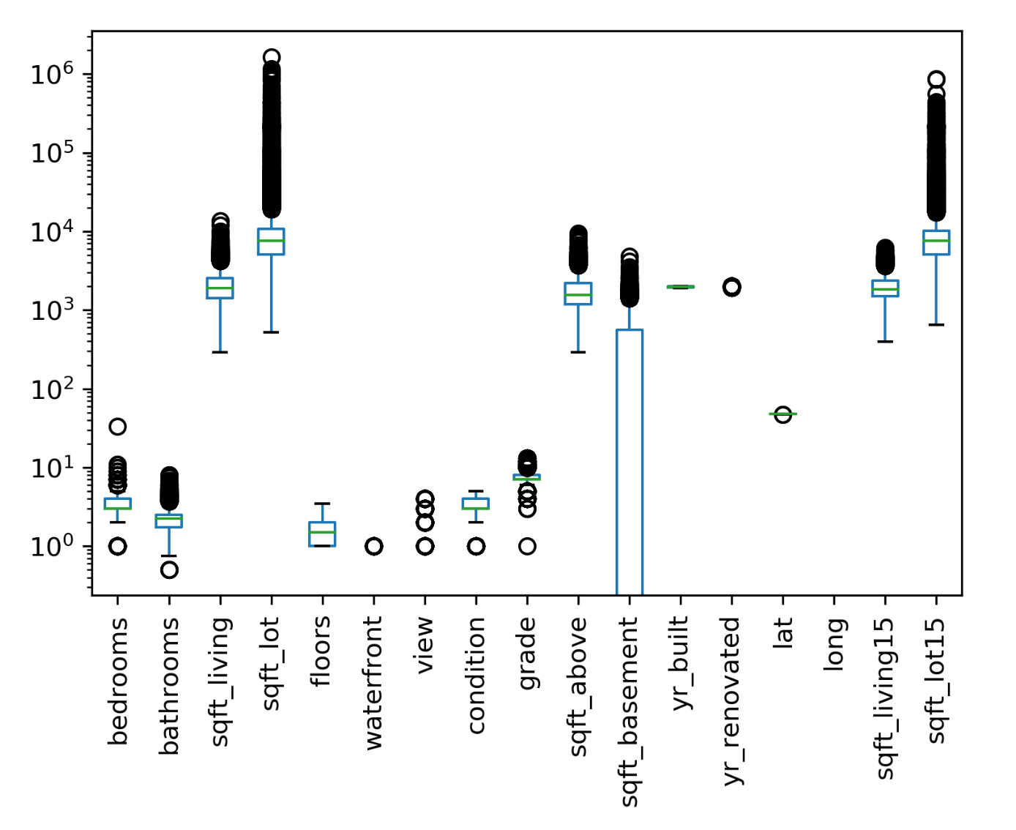
Scaling

Slide 7
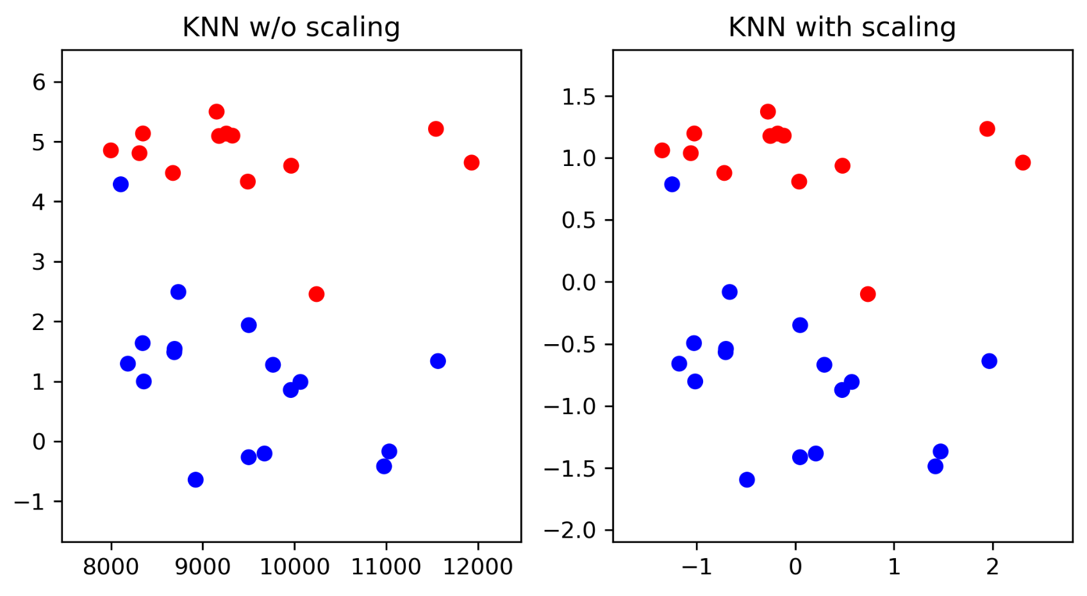
Scaling and Distances

Slide 8
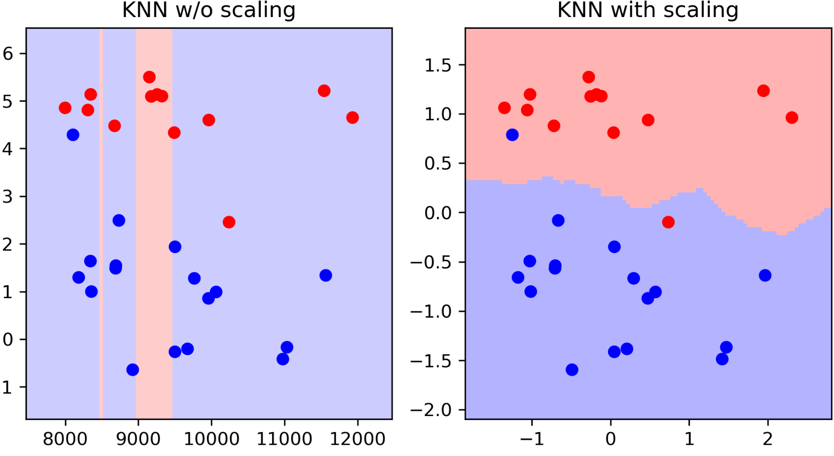
Scaling and Distances

Slide 9
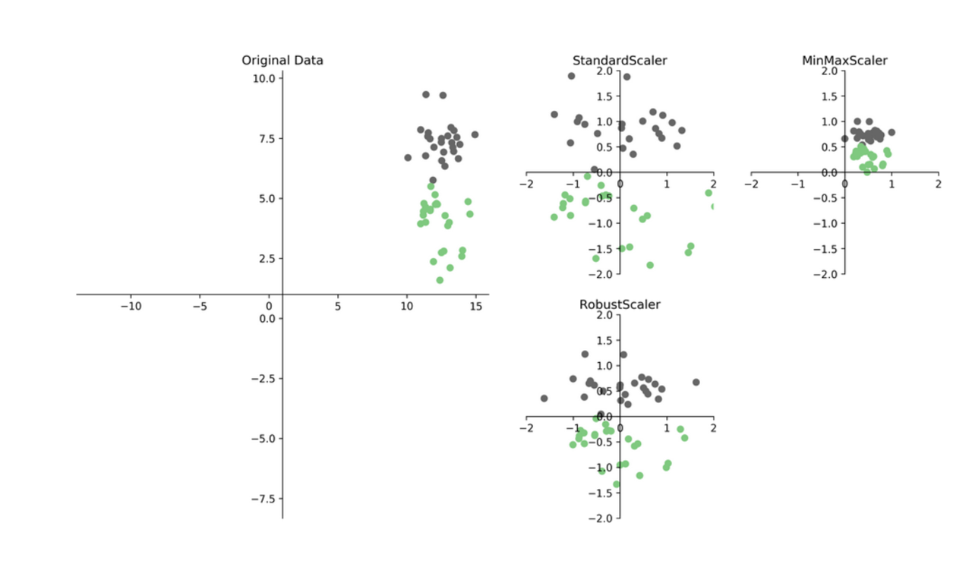
Ways to Scale Data

Slide 10
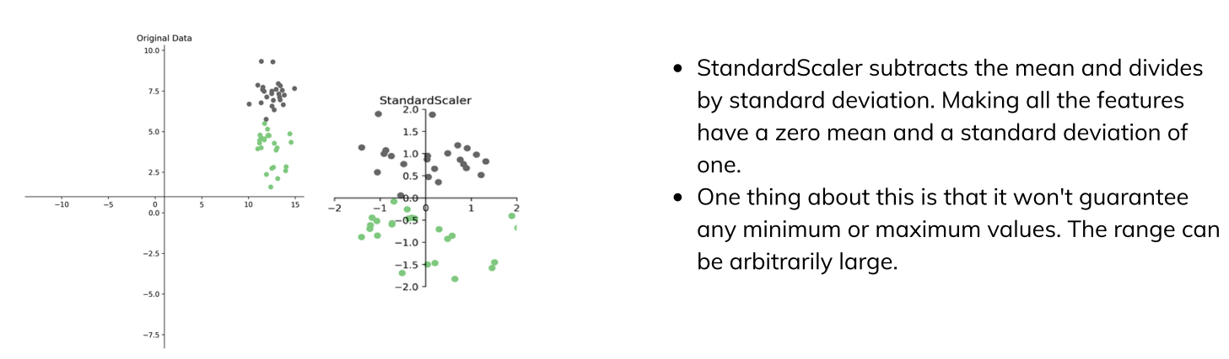
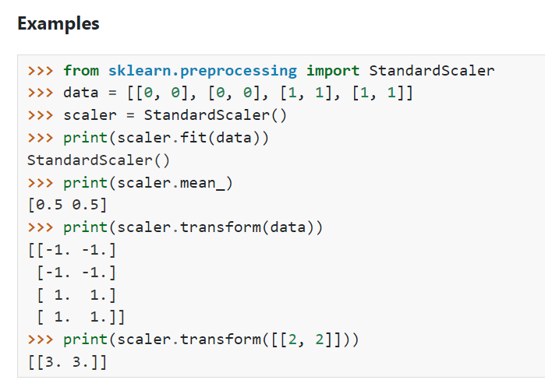
Ways to Scale Data
https://scikit-learn.org/stable/modules/generated/sklearn.preprocessing.StandardScaler.html#sklearn.preprocessing.StandardScaler

Slide 11
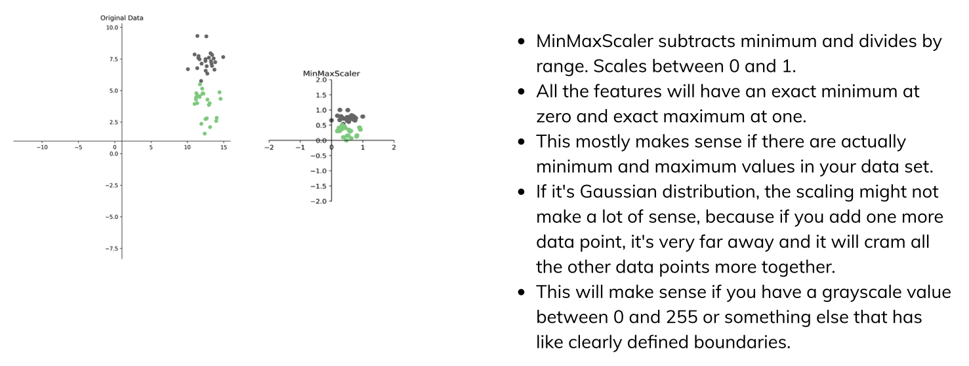
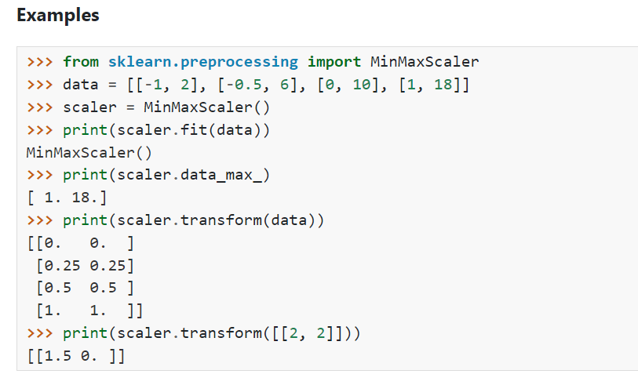
Ways to Scale Data
https://scikit-learn.org/stable/modules/generated/sklearn.preprocessing.MinMaxScaler.html

Slide 12
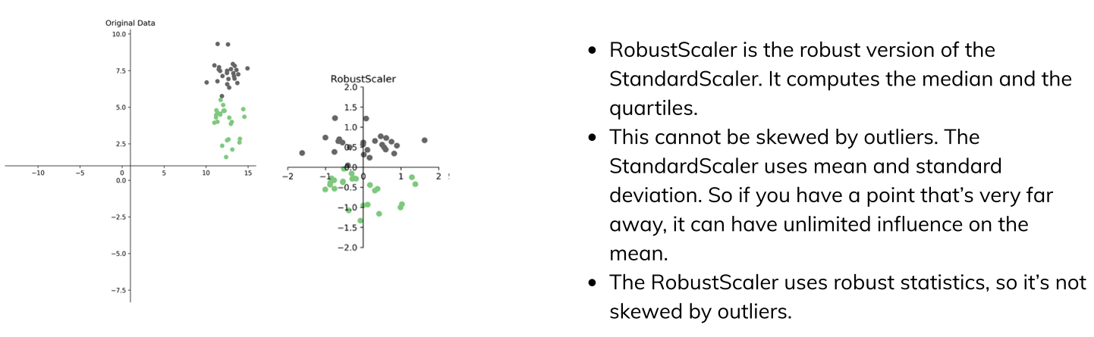
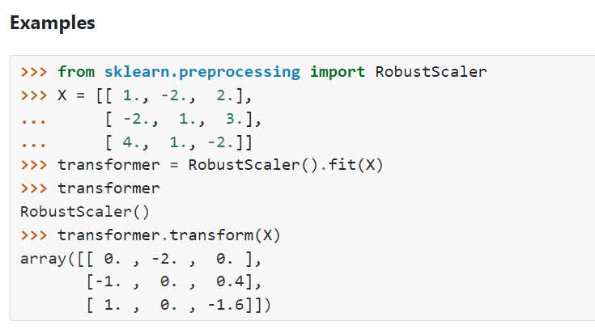
Ways to Scale Data
https://scikit-learn.org/stable/modules/generated/sklearn.preprocessing.RobustScaler.html#sklearn.preprocessing.RobustScaler

Slide 13
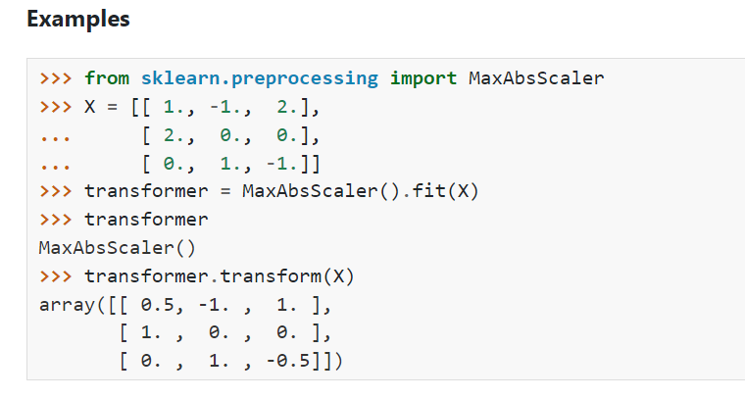
Sparse Data
Data with many zeros – only store non-zero entries.
Subtracting anything will make the data “dense” (no more zeros) and blow the RAM.
Only scale, don’t center (use MaxAbsScaler)
MaxAbsScaler: Scale each feature by its maximum absolute value.
This estimator scales and translates each feature individually such that the maximal absolute value of each feature in the training set will be 1.0. It does not shift/center the data, and thus does not destroy any sparsity.

Slide 14
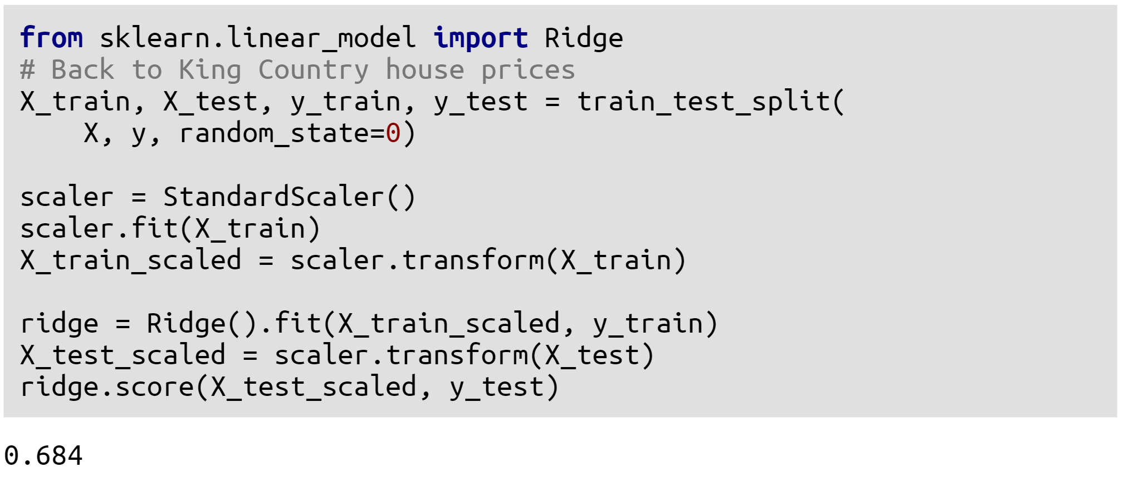
Standard Scaler Example

Slide 15
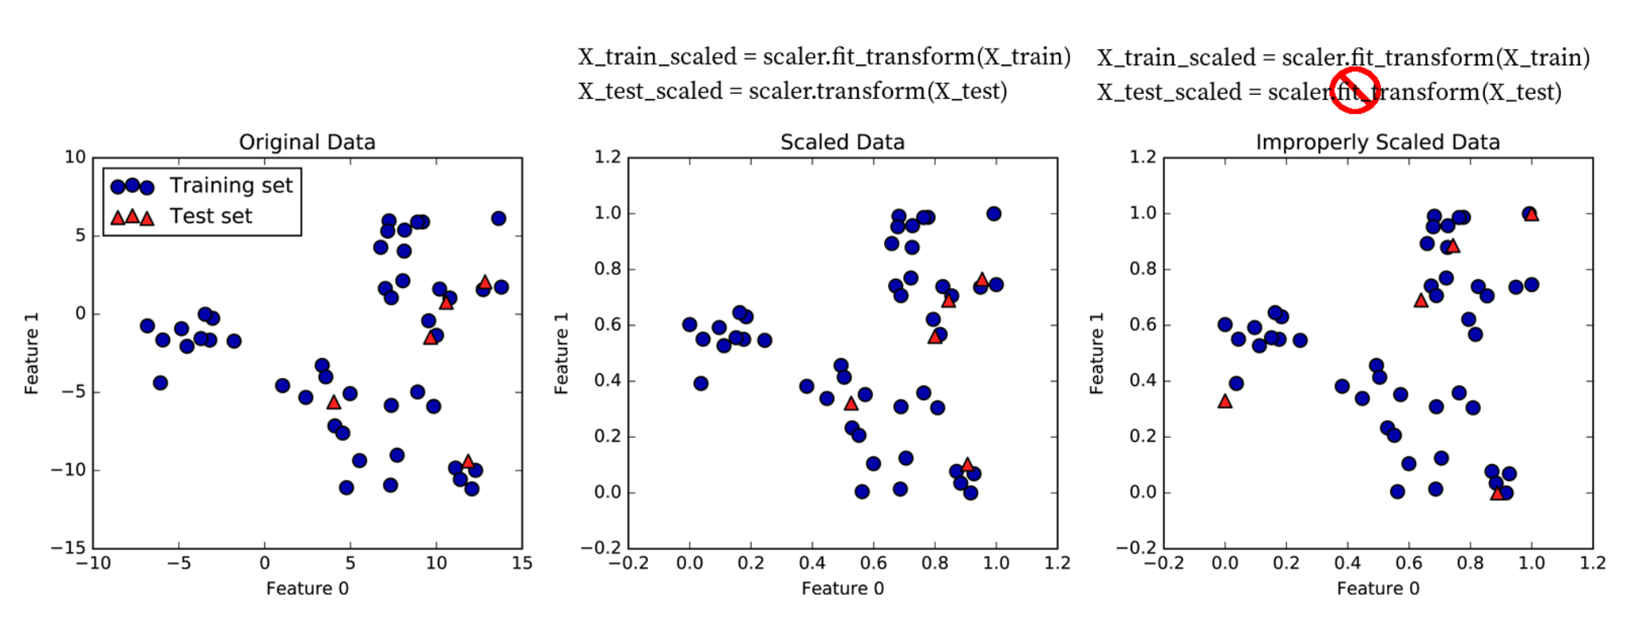
Standard Scaler Example

Slide 16
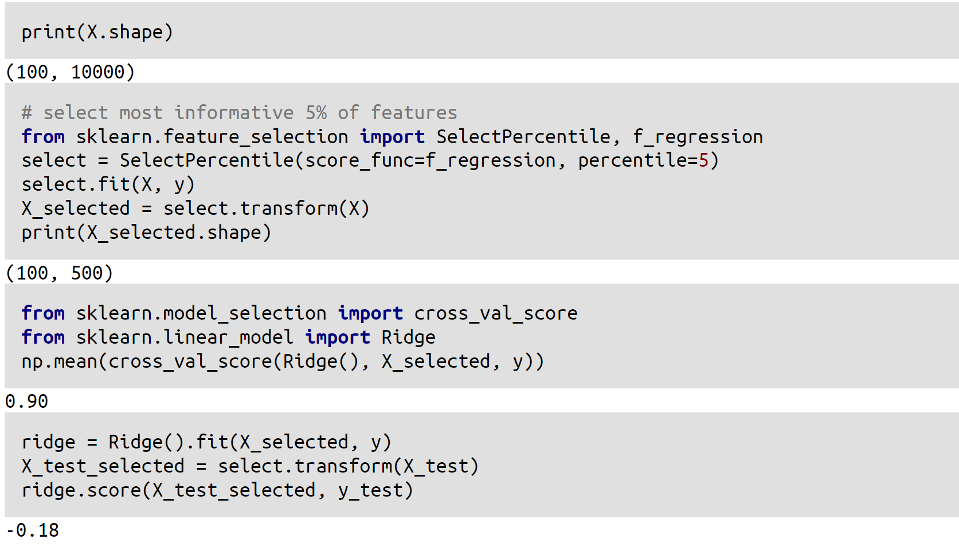
A note on preprocessing (and pipelines)
A common errror

Slide 17
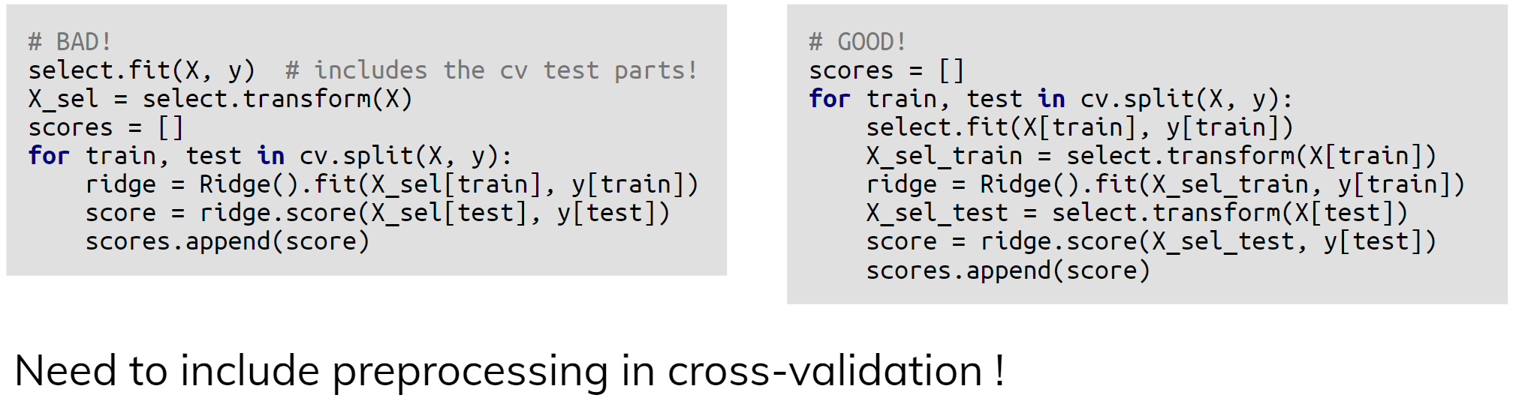
Leaking Information

Slide 18
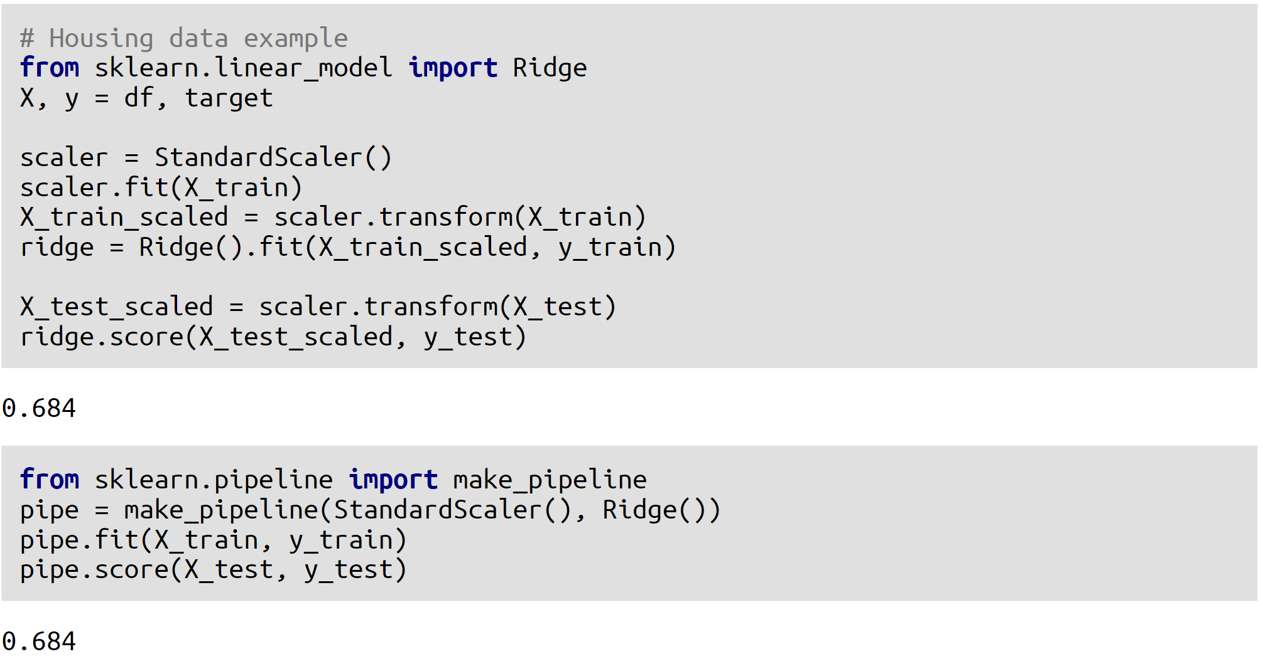

Slide 19
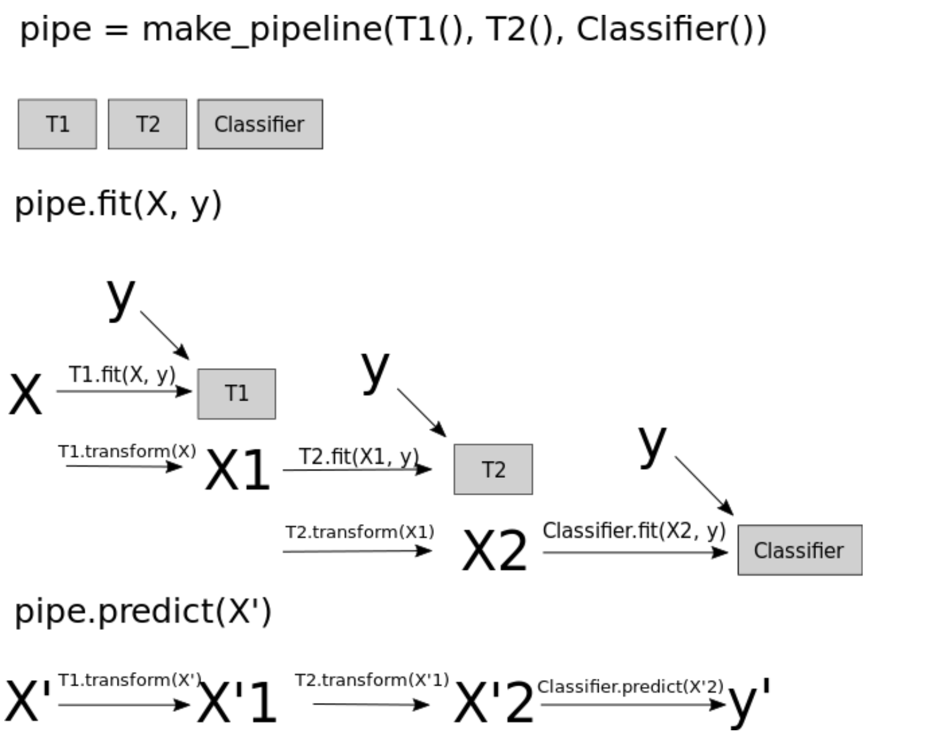

Slide 20
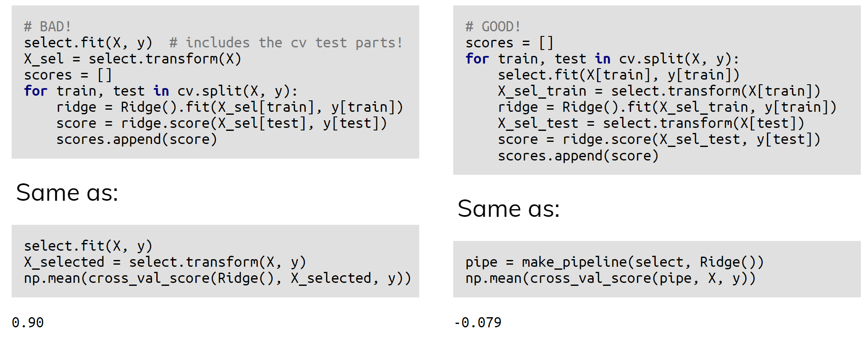
Undoing our feature selection mistake

Slide 21
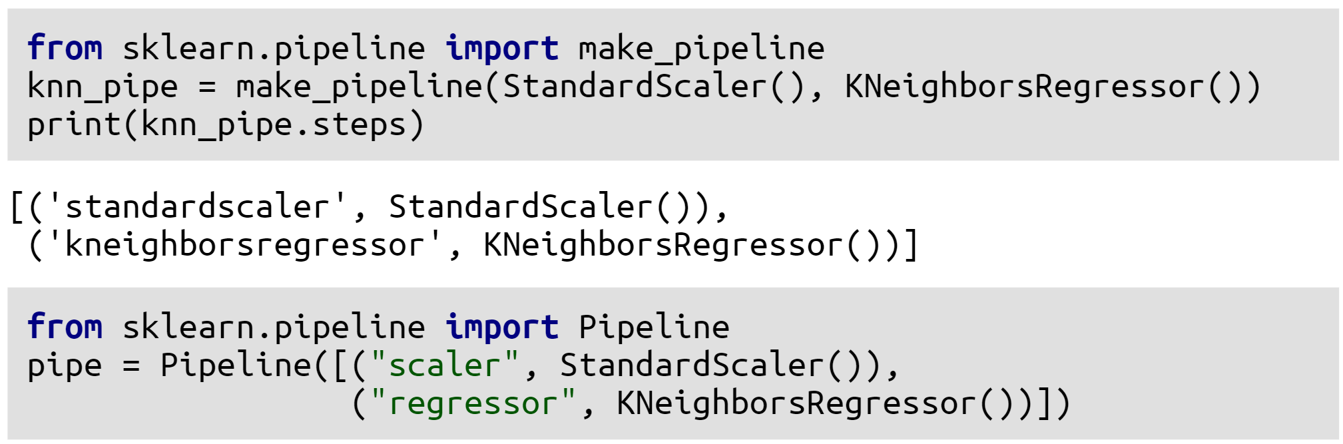
Naming Steps

Slide 22
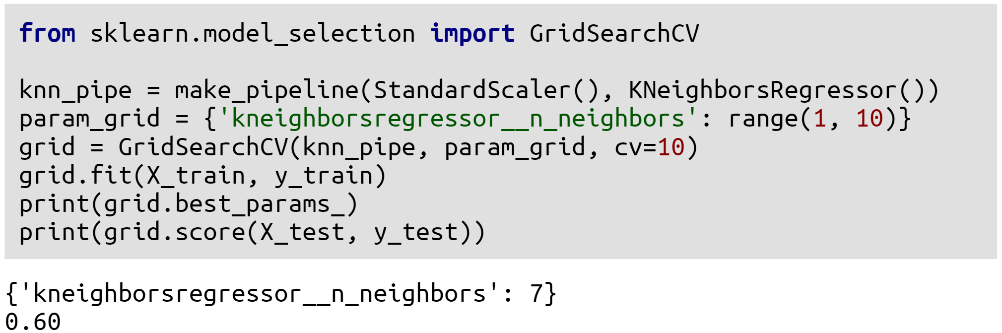
Pipeline and GridSearchCV

Slide 23
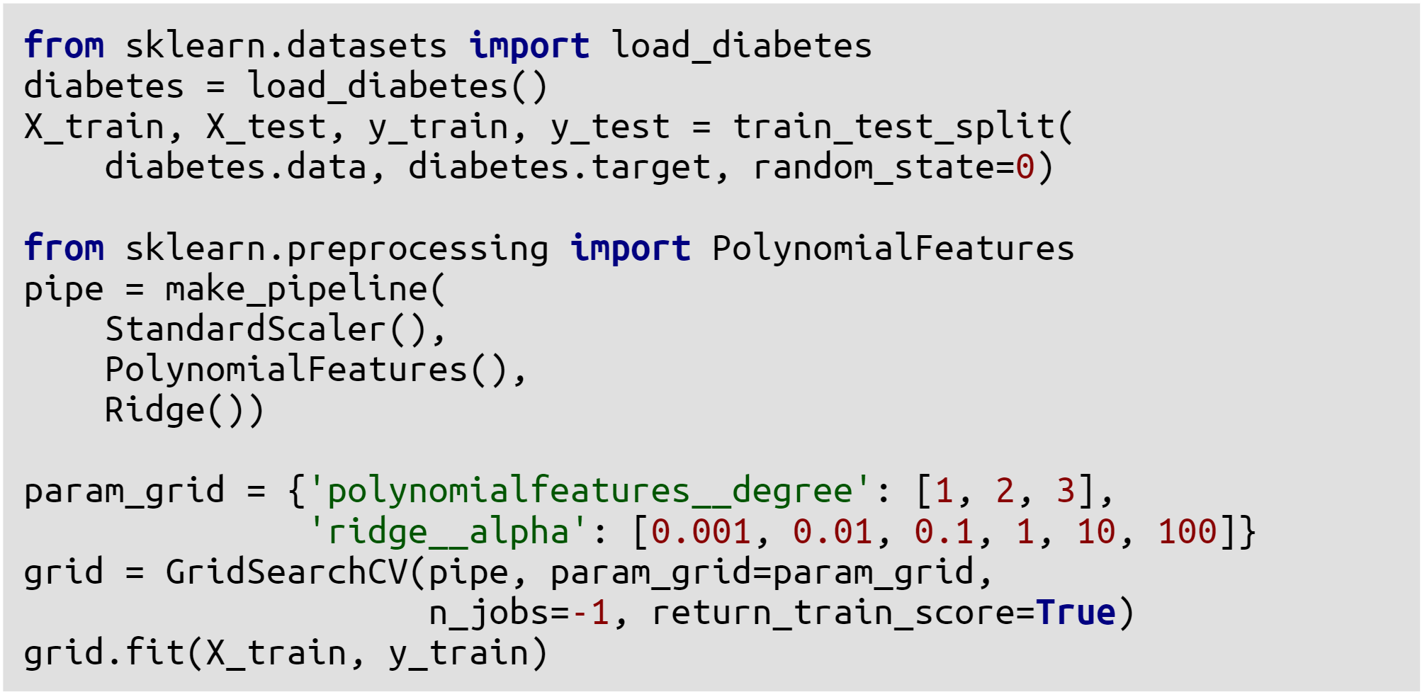
Going wild with Pipelines

Slide 24
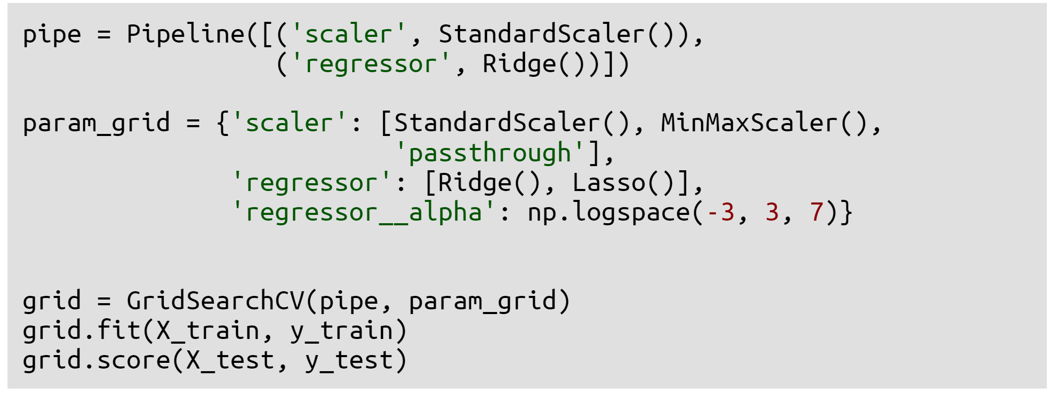

Slide 25
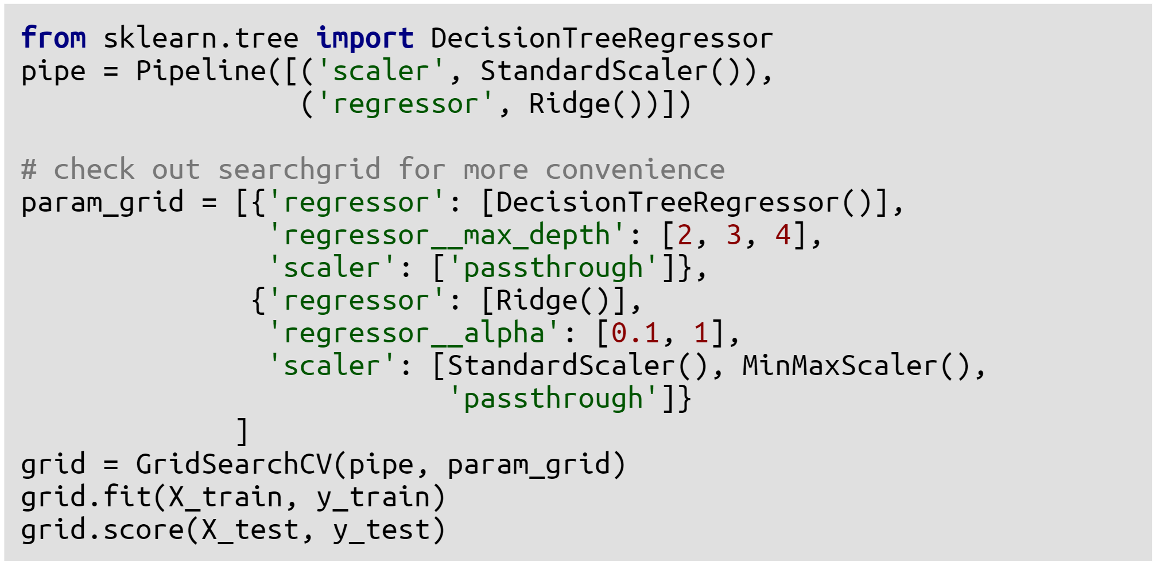

Slide 26
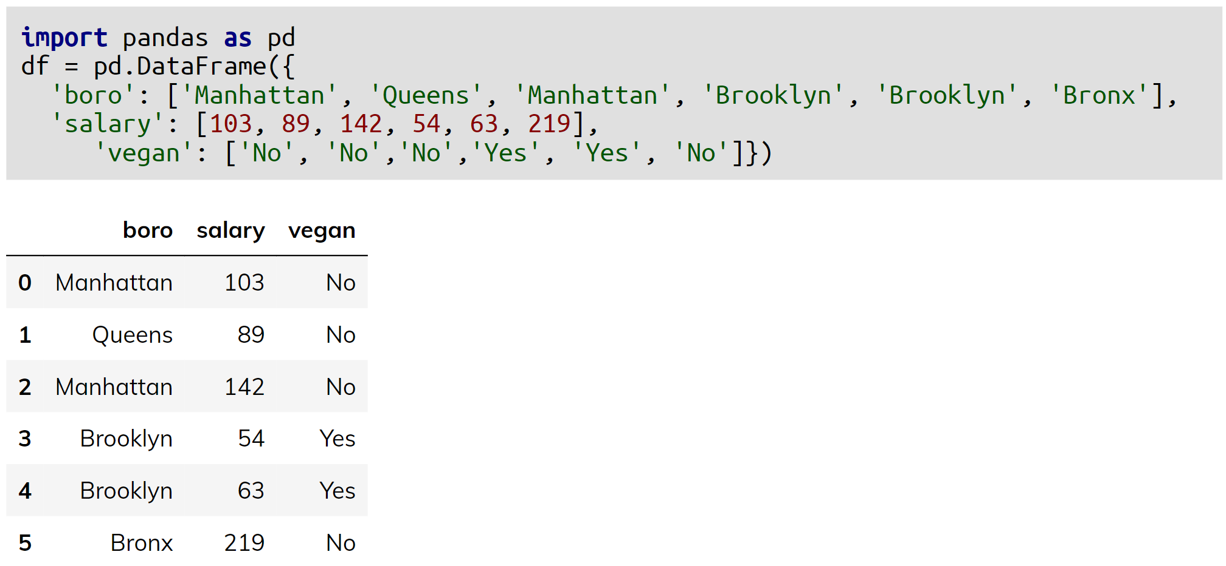
Categorical Variables

Slide 27
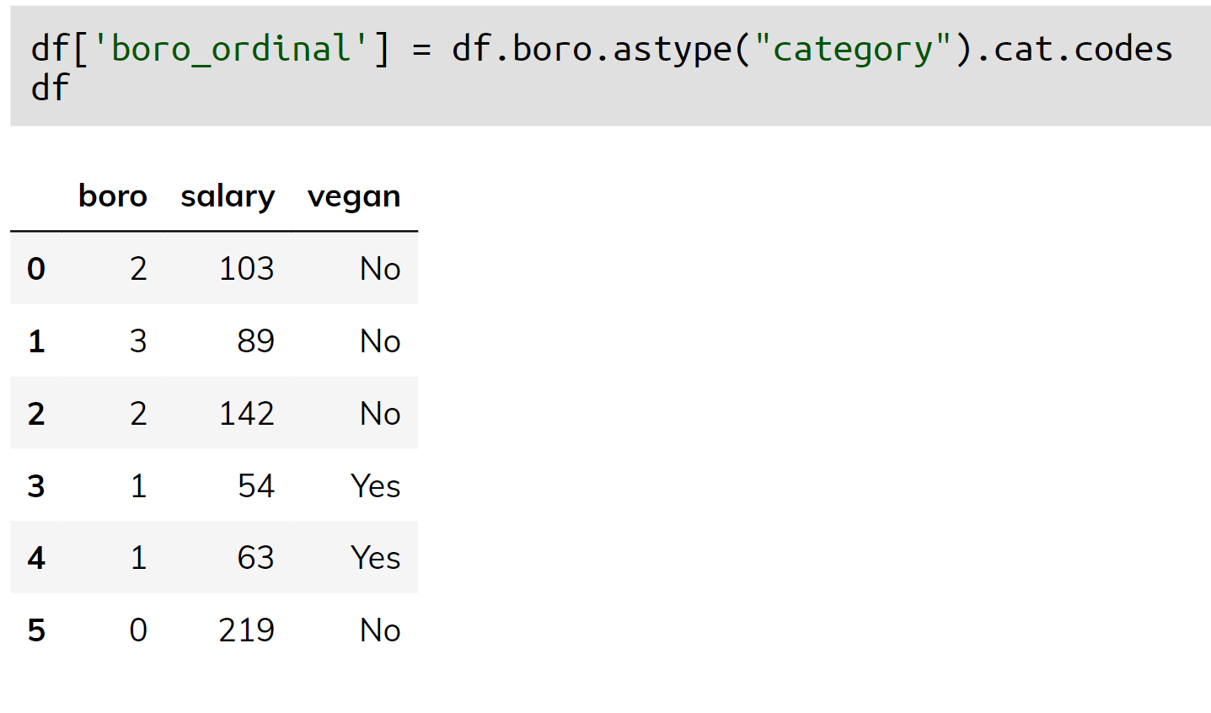
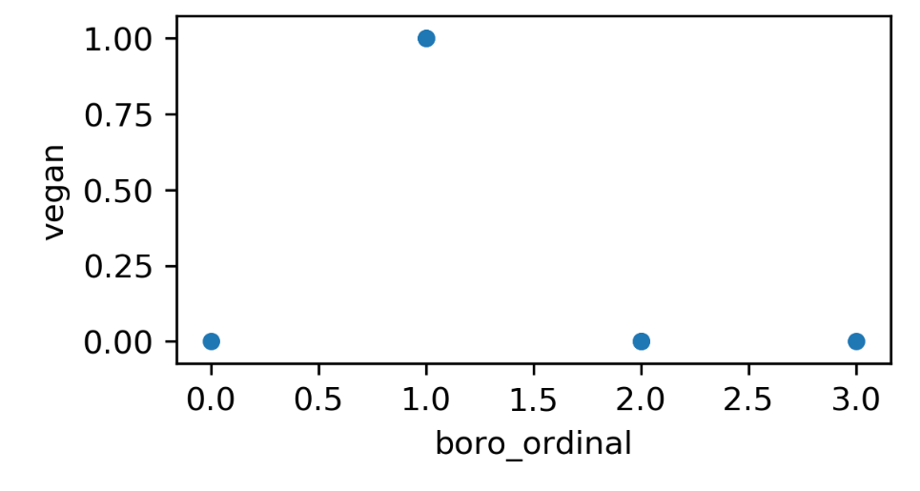
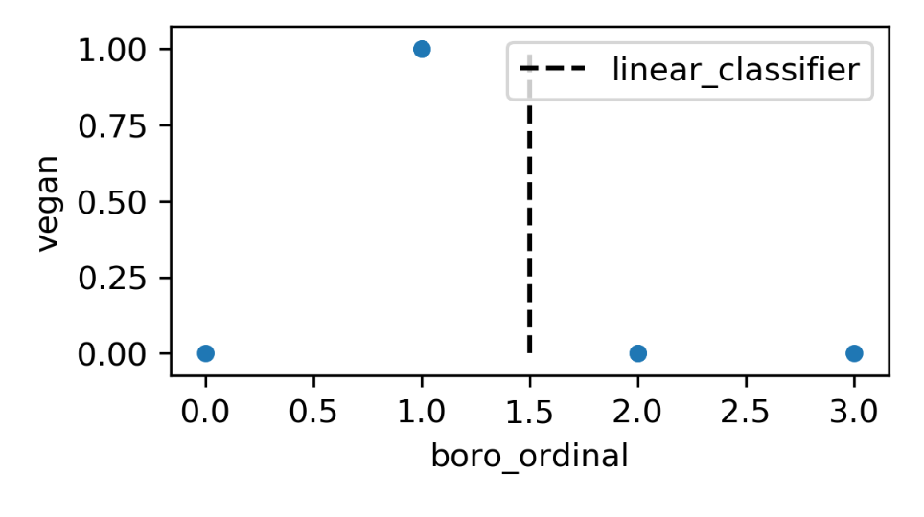
Ordinal encoding

Slide 28
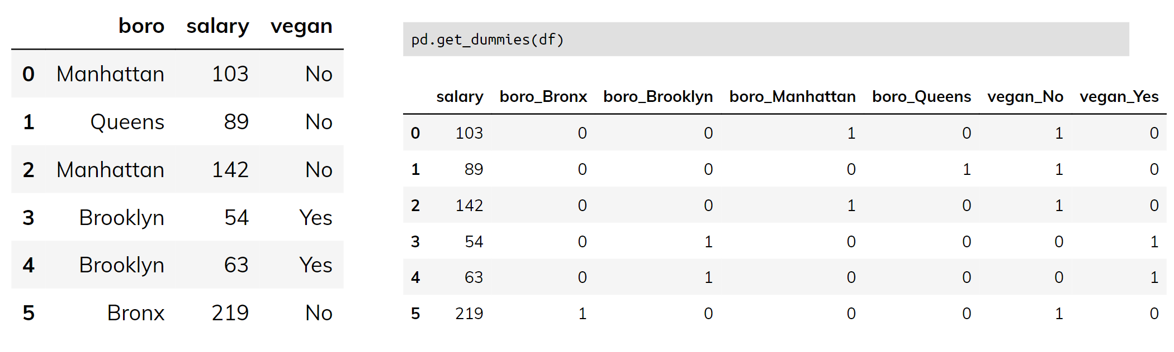
One-Hot (Dummy) Encoding

Slide 29
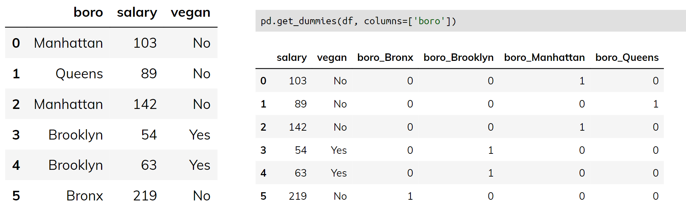
One-Hot (Dummy) Encoding

Slide 30
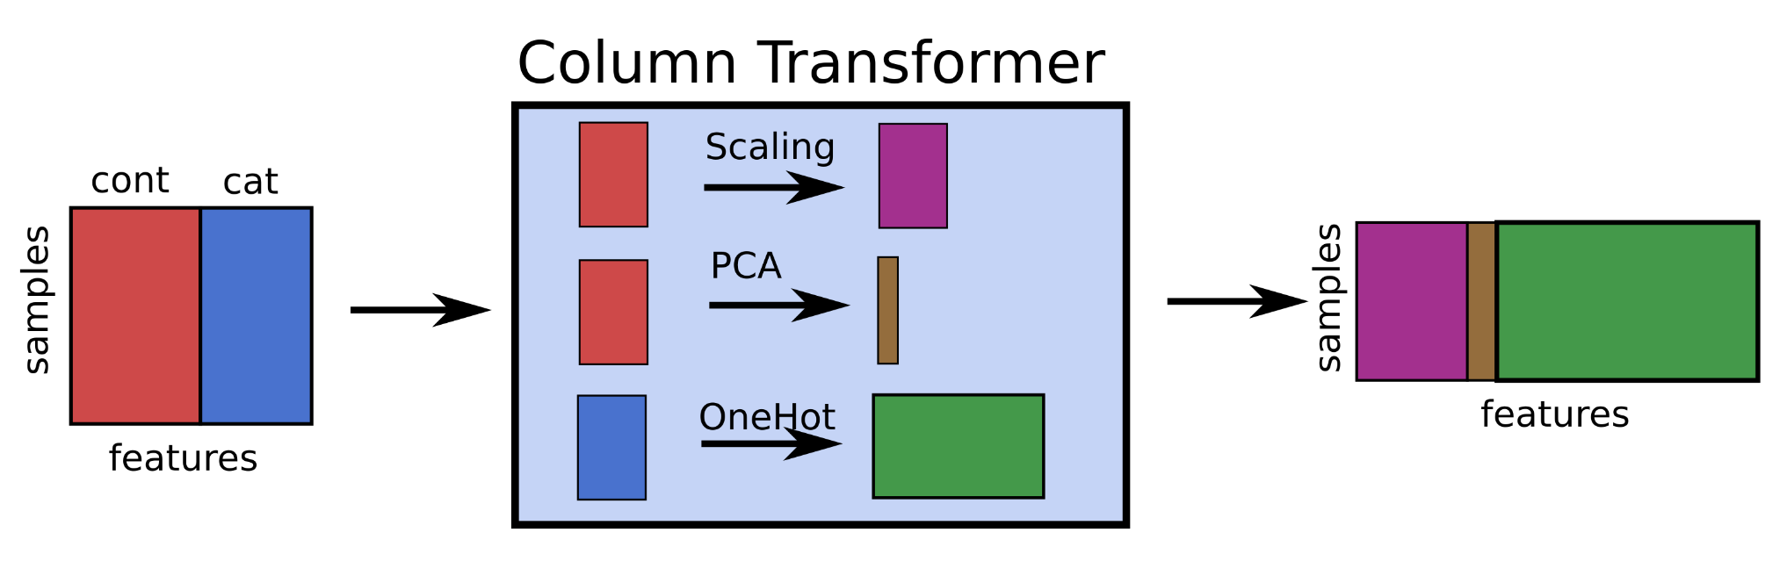
Column Transform

Slide 31
Dummy variables and colinearity
One-hot is redundant (last one is 1 – sum of others)
Can introduce co-linearity
Can drop one
Choice which one matters for penalized models
Keeping all can make the model more interpretable

Slide 32
Models Supporting Discrete Features
In principle:
All tree-based models, naive Bayes
In scikit-learn:
Some Naive Bayes classifiers.
In scikit-learn "soon":
Decision trees, random forests, gradient boosting

Slide 33
Target Encoding (Impact Encoding)
For high cardinality categorical features
Instead of 70 one-hot variables, one “response encoded” variable.
For regression:
"average price in zip code”
Binary classification: – “building in this zip code have a likelihood p for class 1”
Multiclass: – One feature per class: probability distribution

Slide 34
Target Encoding (Impact Encoding)
More encodings for categorical features:
https://contrib.scikit-learn.org/category_encoders/

